Slide 1


Time Series Analysis and forecasting
Vaishnavi Kokadwar
Kanav Goyal
Mahender Reddy
Ulka Khobragade

Slide 2
Table of contents
01
02
03
04
05
06
PROBLEM STATEMENT
Data analysis
modelling
evaluation
conclusion
Future work

Slide 3
PROBLEM STATEMENT and impact
Core Challenge:
Develop a machine learning model that can predict receipt volumes for the upcoming year based on historical daily receipt data.
Business Impact:
Receipt volume directly impacts revenue forecasting and operational capacity planning
Understanding seasonal patterns and growth trends is critical for strategic decision-making
Accurate predictions help optimize staffing, server infrastructure, and marketing expenditures
Proactive response to anticipated volume changes creates competitive advantage
What We Want to Accomplish:
Build a time series prediction model for receipt volume forecasting
Transform daily historical data into monthly future projections
Create an end-to-end solution from data processing to visualization

Slide 4

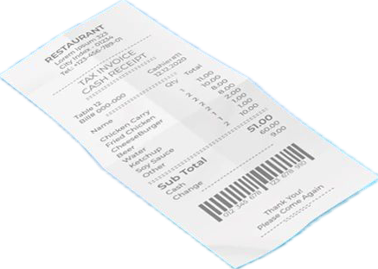
Data overview
Data Source
Open source reward app data
Daily receipt scanning activity
Provided as CSV time series format
Data Shape
365 daily observations (rows)
2 columns: Date and Receipt_Count
Complete data with no missing values
Time Range - January 1, 2021 to December 31, 2021

Slide 5
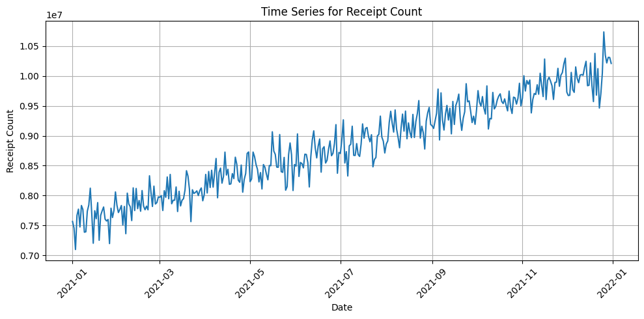
Exploratory data analysis
Upward Trend
Fluctuating Variance
Regular repeating patterns suggesting seasonality
Non-stationary data

Slide 6
Feature Engineering
Day of Week | 0-6 value capturing weekly shopping cycles
DAY | Calendar day (1-31), shows monthly spending patterns
MONTH | Month (1-12), tracks seasonal trends
QUARTER | Financial quarter (1-4), identifies business cycles
YEAR | Calendar year (2021), enables trend analysis
DAY OF YEAR | Position in year (1-365), precise seasonal tracking
WEEK OF YEAR | Week number, identifies holiday shopping weeks
Receipt count (Lag 1) | Previous day's volume, strongest predictor
Receipt count (Lag 2) | Two-day-ago volume, very recent trends
Receipt count (Lag 7) | Prior week's same-day volume, weekly cycles
Receipt count (Lag 14) | Two-week-ago volume, bi-weekly patterns
Receipt count (Lag 28) | Month-ago volume, monthly patterns
IS_WEEKEND | Binary flag for Sat/Sun shopping behavior
IS_MONTH_END | Flag for end-of-month spending spikes
IS_MONTH_START | Flag for beginning-of-month payment cycles
IS_QUARTER_END | Flag for quarterly financial boundaries
IS_QUARTER_START | Flag for new budget period beginnings
IS_HOLIDAY | Flag for US holidays affecting shopping patterns

Slide 7
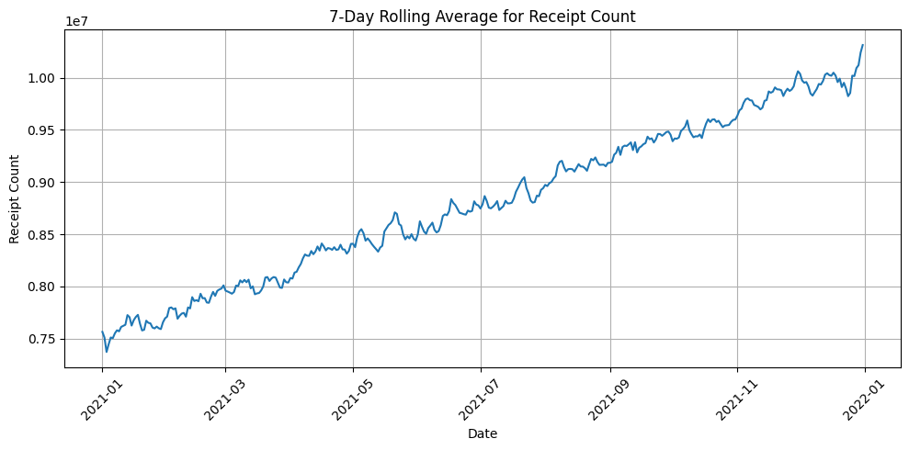
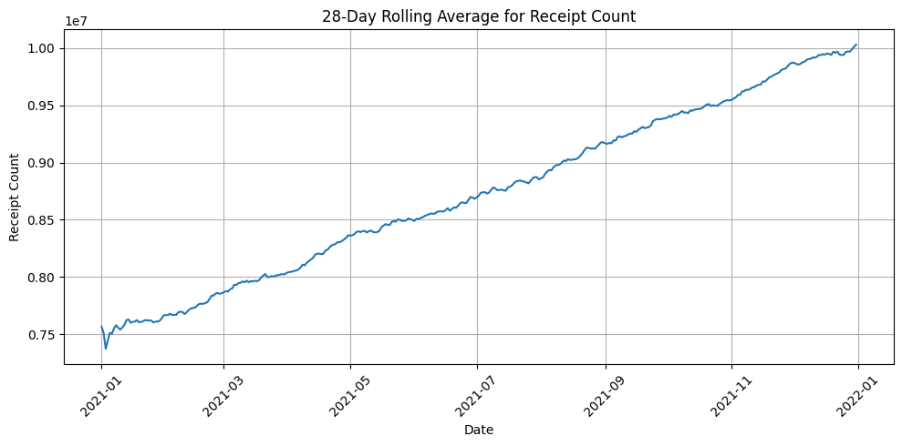
Rolling average trend
Notes:
We use 7-day or 28-day rolling averages to smooth out short-term fluctuations in the data and identify longer-term trends or patterns. Here's why these specific periods are common: These rolling averages are essential for making data more interpretable and removing noise caused by short-term volatility.

Slide 8
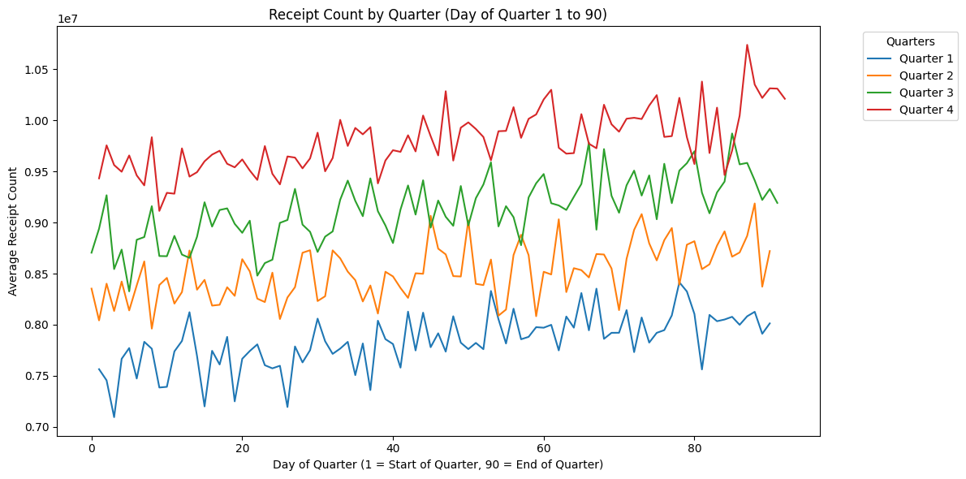
Receipt count/ seasonality
Seasonal variance calculated for following periods: 7, 30, 60, 90, 365
Best variance at 90 day period - suggesting Quarterly seasonality
Can be used as a parameter in SARIMA and other seasonality based models

Slide 9
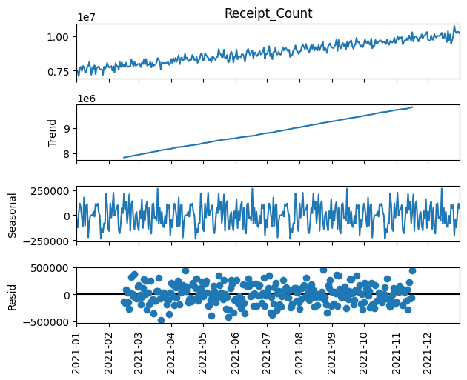
Seasonal decomposition
Period = 90 days
Trend is the strongest component

Slide 10
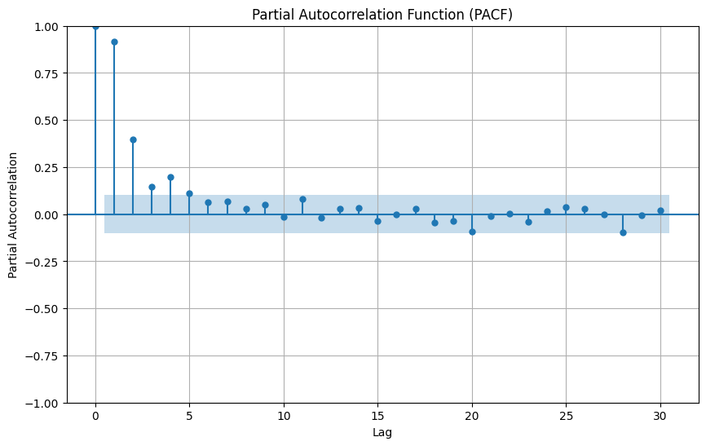
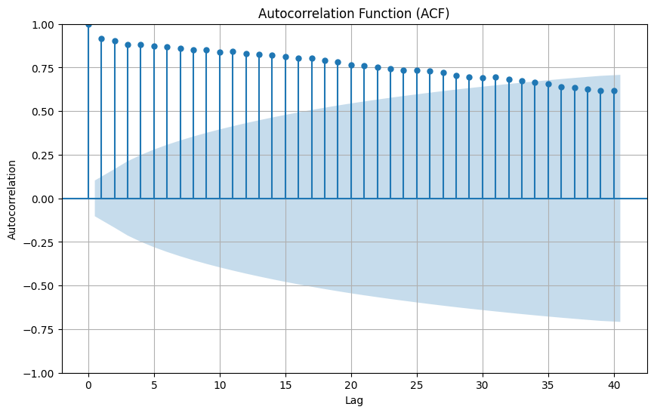
Analyzing Correlation Plots
Highest significant lag in PACF: 4
Gradual decay – Suggests trend in time series

Slide 11


Modelling

Slide 12
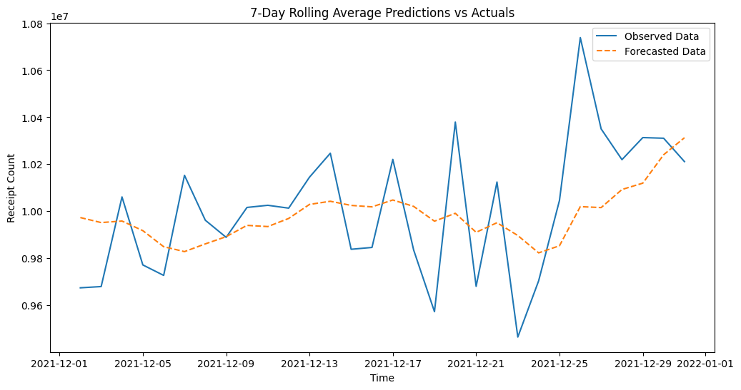
Baseline model
7 day moving average
Notes:
Sets a threshold for metrics for further modelling
Not a sustainable model - error can compound for longer horizons, Only considers information for 7 days, not useful for long term patterns.

Slide 13
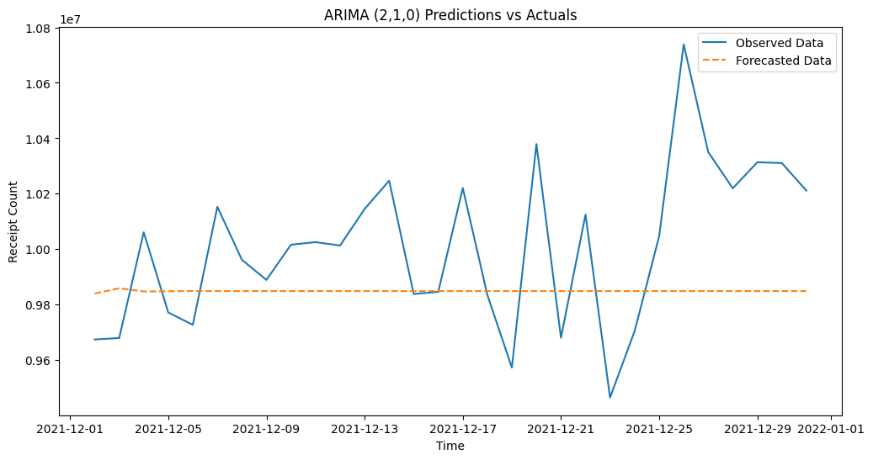
Auto-arima model
Parameters chosen based on Auto-ARIMA implementation
Seasonal influence is minimal based on Auto-ARIMA results
Does not capture trends or peaks
Notes:
P,d,q

Slide 14
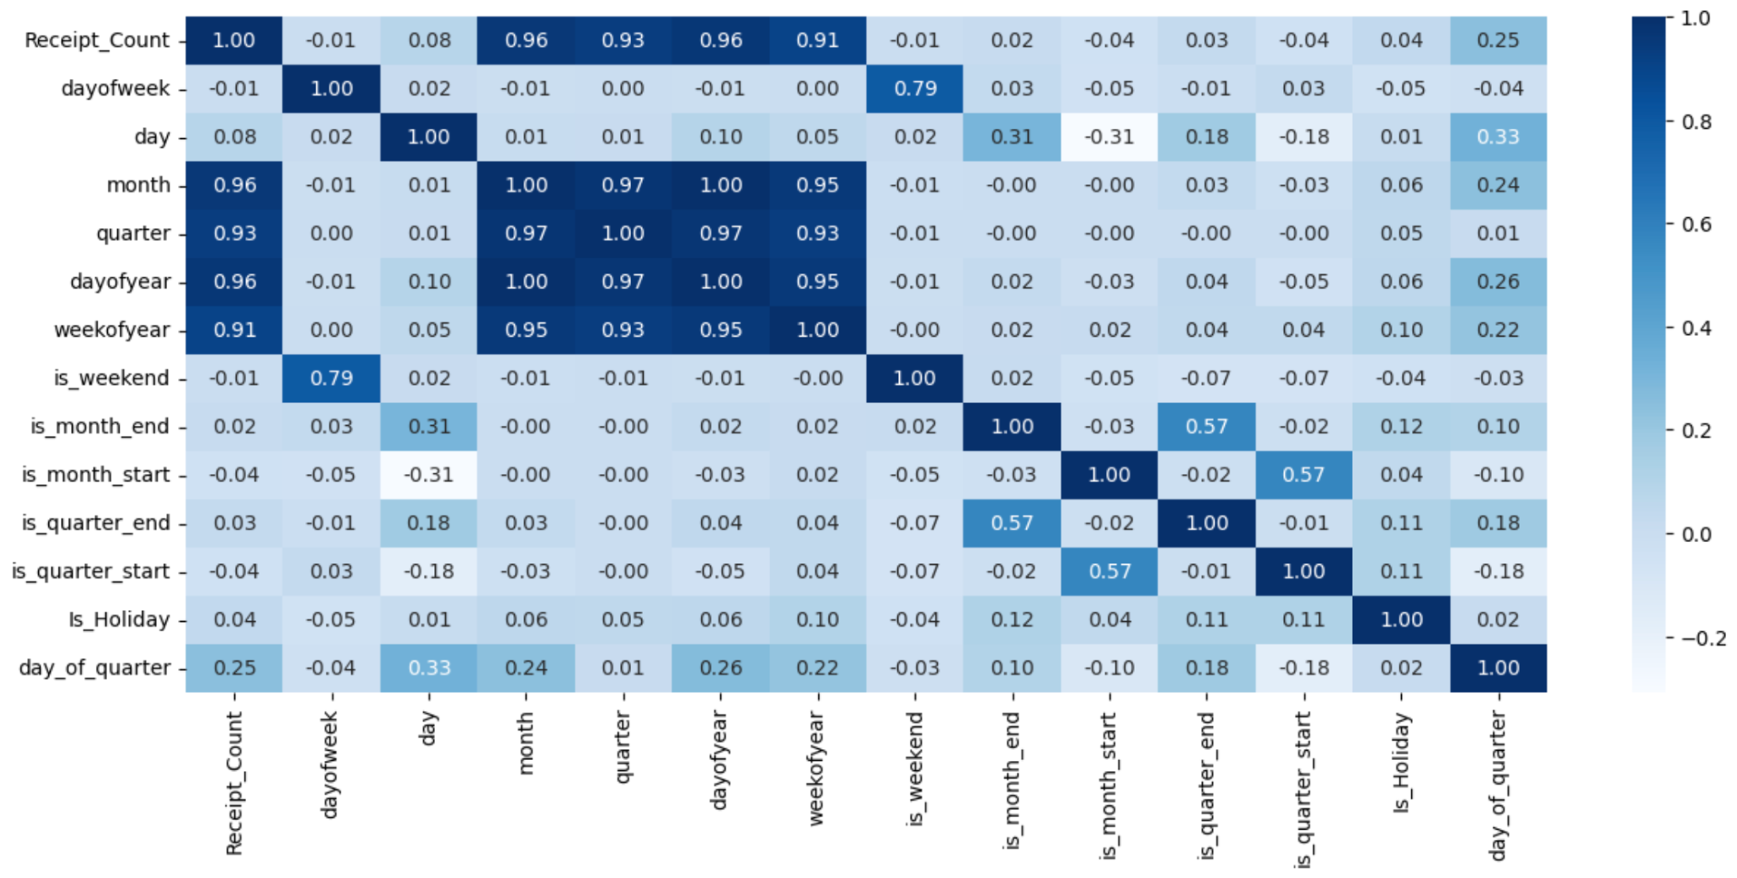
Correlation matrix
Month
Quarter
Day of year
Week of year
Day of Quarter
Notes:
Adding exogenous variable - strong correlation between xyz and receipt_count

Slide 15
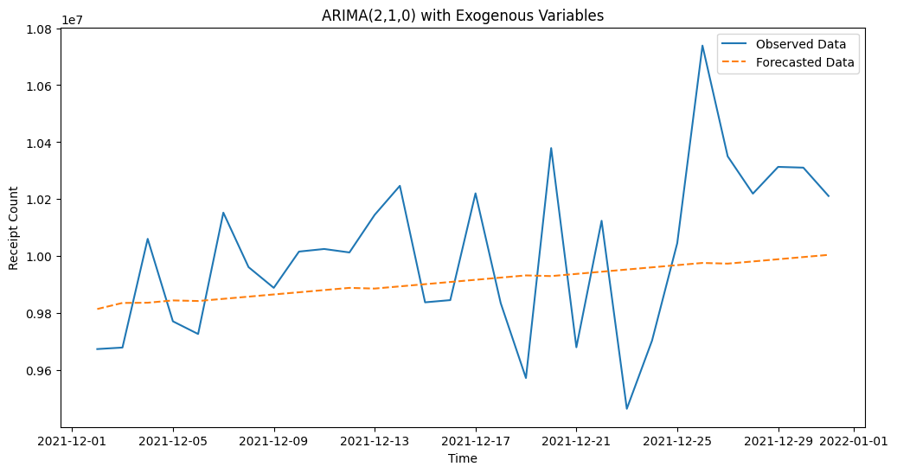
Arima with exogenous variables
Added Exogenous variables like ‘Day of Week’, ‘Quarter’, ‘Month’, etc.
Captures the general trend but does not capture the peaks and troughs

Slide 16
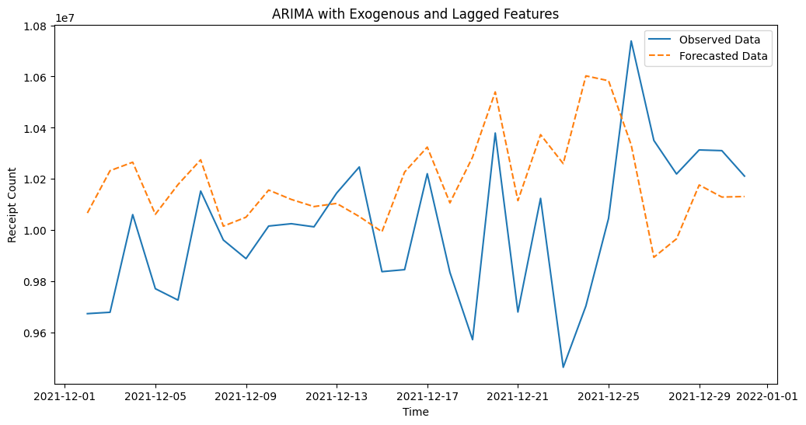
Arima with exogenous & lagged features
Added Exogenous variables like ‘Day of Week’, ‘Quarter’, ‘Month’, and lagged features like “Receipt_Count_Lag1’, etc.
Captures the general trend and peaks but insignificant variables found in model summary
Notes:
Many of these features had minimal/no significance on the model’s performance based on the model’s summary (p-values)

Slide 17
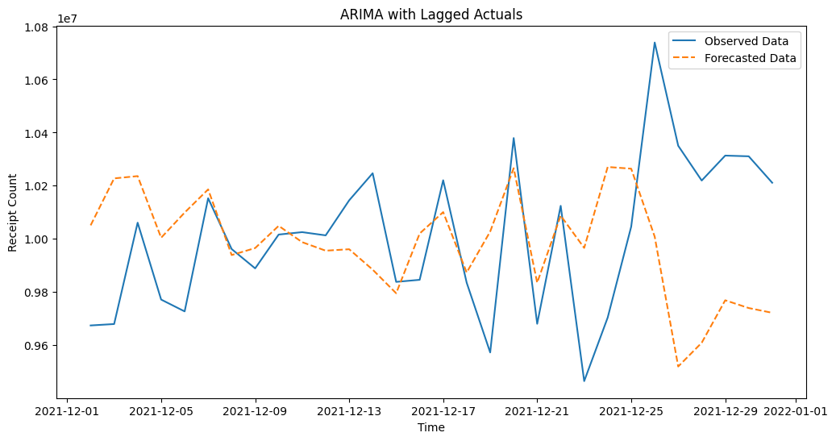
Arima with lagged actuals
Uses the best performing parameters and exogenous variables
Only includes “Lag_1” and “Lag_2” features
Captures the overall peaks and direction of the time series
Notes:
Best-performing stat model

Slide 18
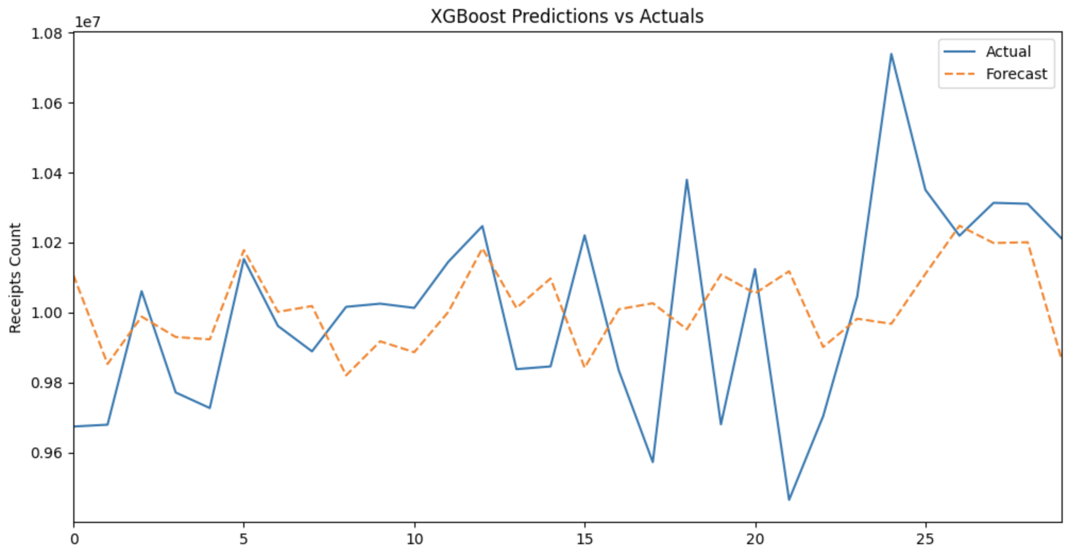
Xgboost model
Used for its ability to handle nonlinear relationships, outliers and missing values
Good at capturing the general trend of the time series and has good evaluation metric performance

Slide 19
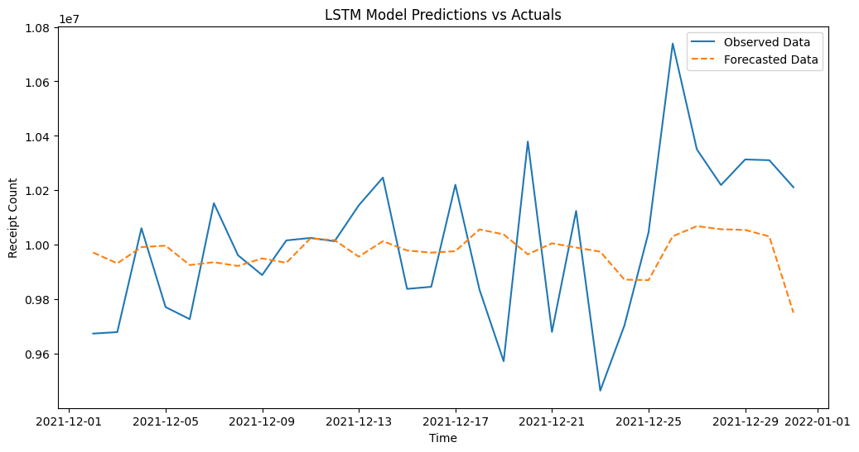
Lstm model
Used since it captures high-frequency data with long-term dependencies
Useful in capture non-linear relationships within the series

Slide 20
Model
Evaluation

Slide 21
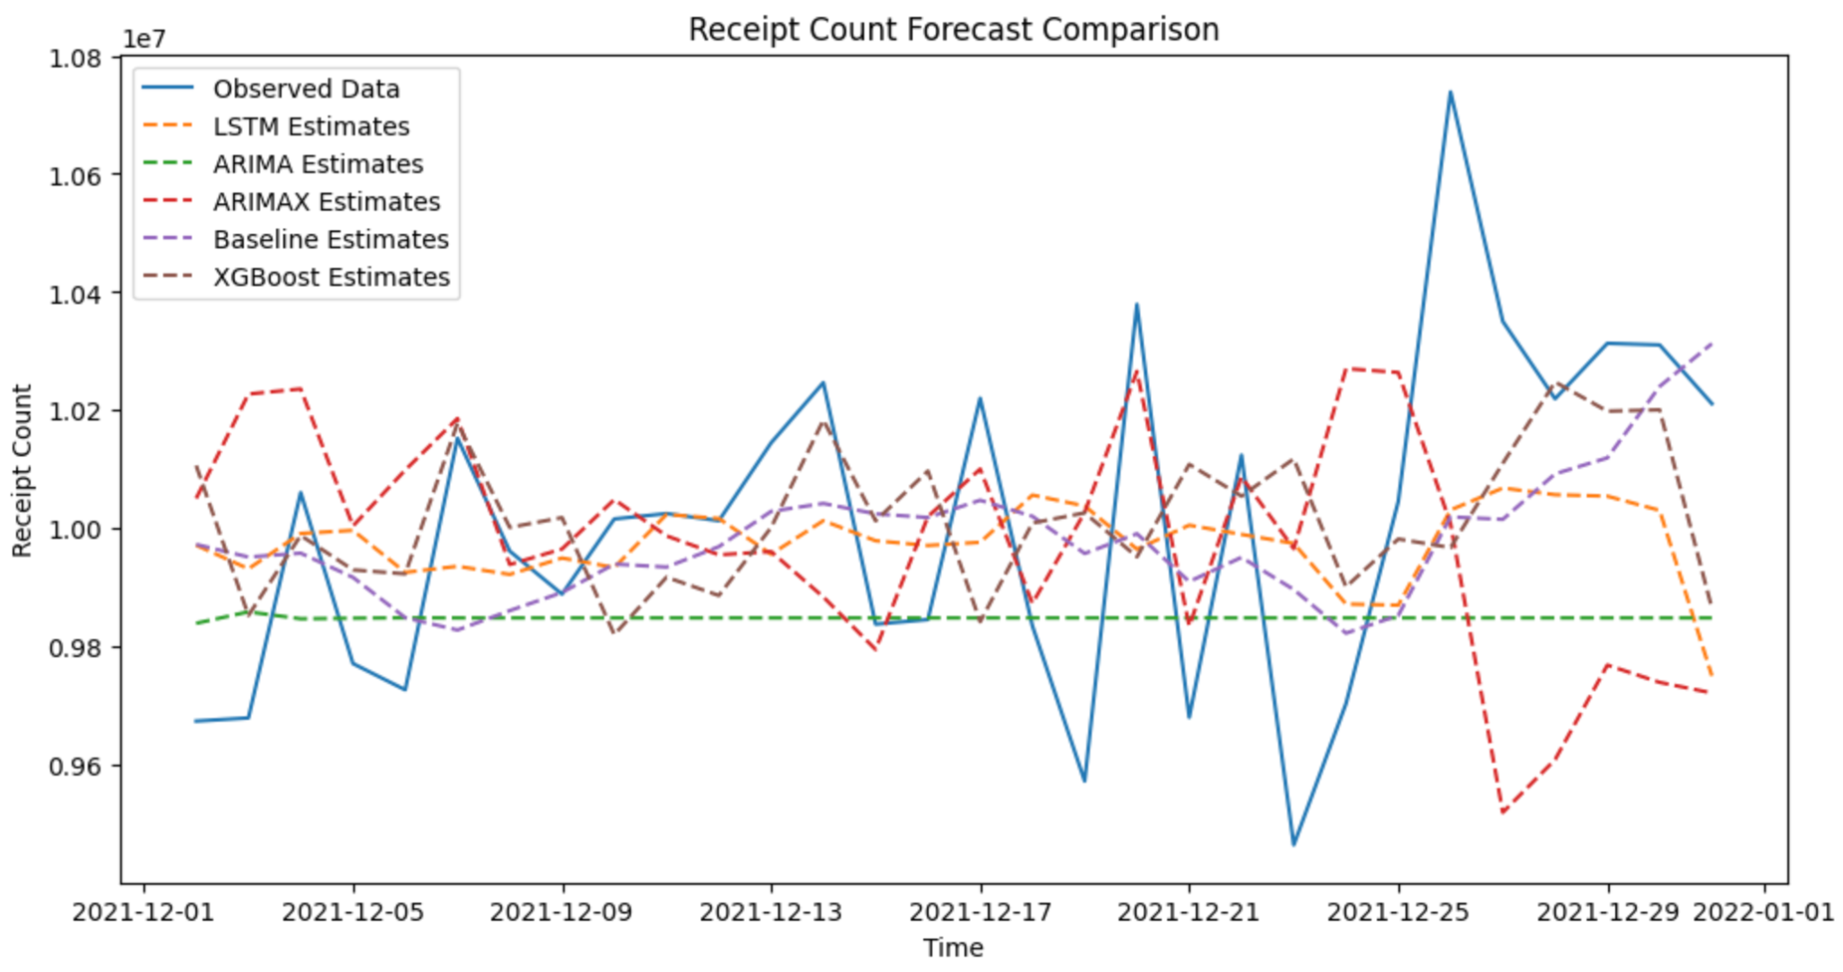
Model comparison

Slide 22
Evaluation metrics
 | MAPE | RMSE | MAE | Directional Accuracy
7-day rolling average | 2.03% | 247928.82 | 202851.47 | 62%
ARIMa | 2.61% | 322278.23 | 261495.25 | 34%
Arima with exogenous variables | 2.32% | 279181.23 | 232391.52 | 52%
ARIMA with exogenous & lagged features | 3.00% | 372889.70 | 299765.87 | 69%
Arima with lagged actuals | 2.90% | 374875.67 | 290326.97 | 72%
XGBoost | 2.25% | 289092.56 | 224897.64 | 55%
LSTM | 2.31% | 279038.17 | 231533.97 | 52%
Notes:
Best model - MAPE &

Slide 23
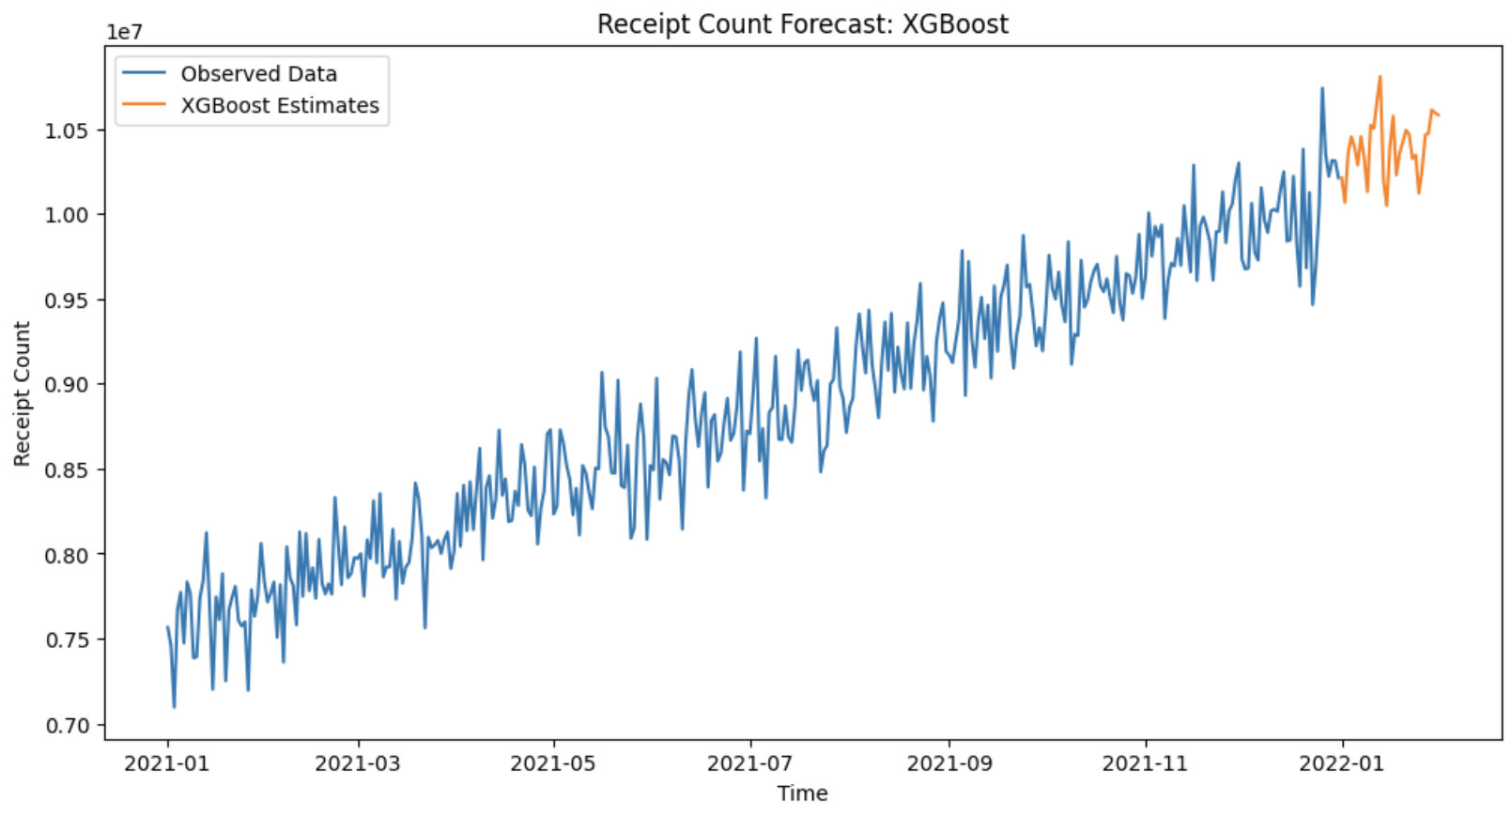
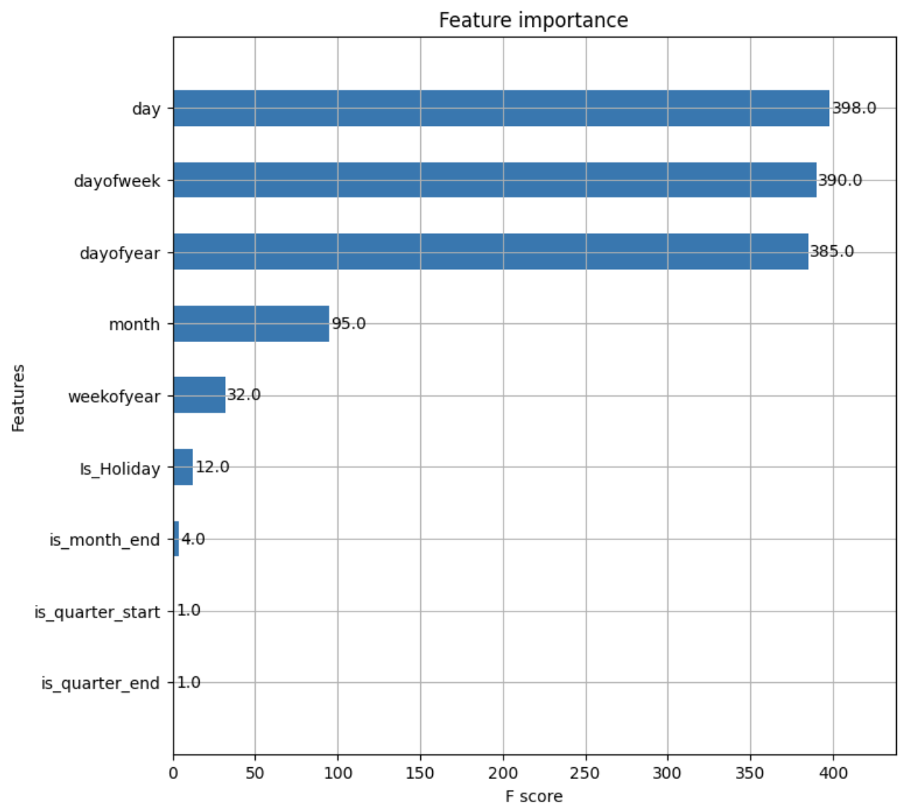
conclusion
Xgboost is the best model
Best MAPE (2.25%) and MAE
High explainability due to feature importance graph
Computational efficiency; more scalable and efficient
Notes:
Future prediction for next month - Jan 2022

Slide 24
Future scope
Add more data
Add more features
Ensemble approaches
Add more historical data to accurately capture annual trends and seasonality
Add more specific features like location of the receipts, transaction type, etc. to get drilled-down forecasts
Combine XGBoost with SARIMA models to capture both linear and non-linear patterns

Slide 25
Thanks!

